Slide 1
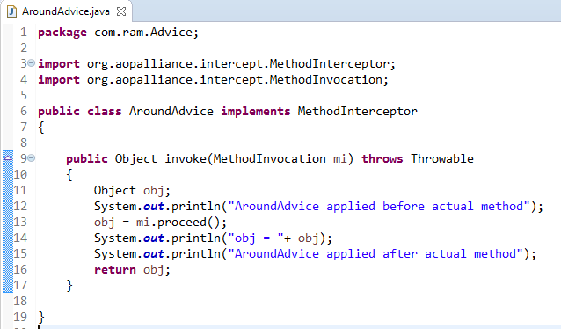
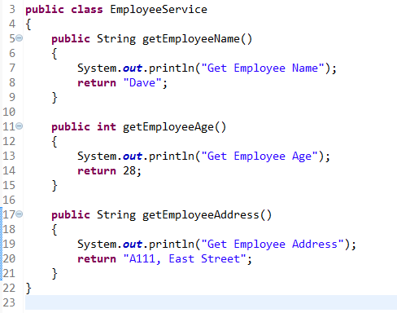
Around Advice
Around Advice is executed before and after the actual method call.
method
Around Advice

Slide 2
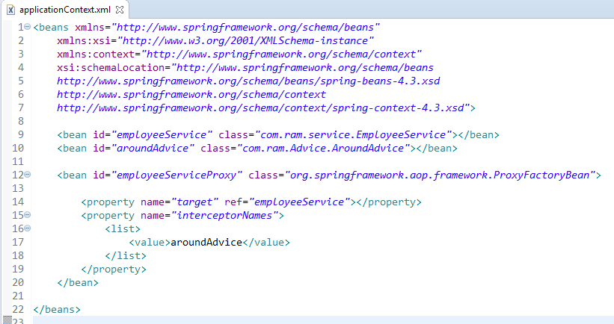
In xml file, create 3 beans, one for EmployeeService class, second for AroundAdvice class and third for ProxyFactoryBean class.
The ProxyFactoryBean class is provided by Spring Famework. It contains 2 properties target and interceptorNames. The instance of EmployeeService class will be considered as target object and the instance of AroundAdvice class as interceptor.

Slide 3
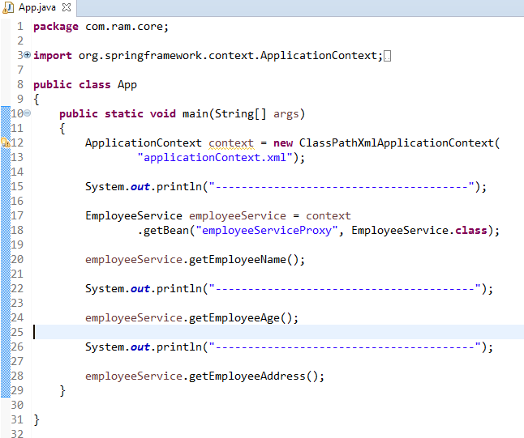

Slide 4
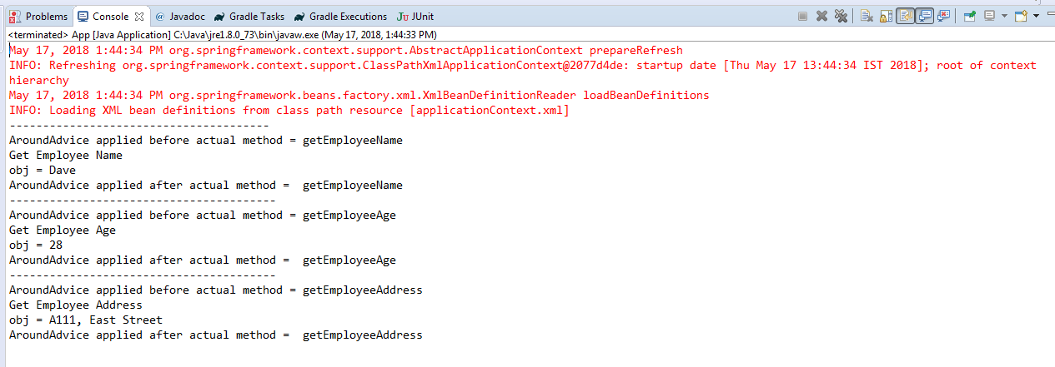
In this AOP advice example, the all methods of a class are intercepted automatically.
But for most cases, we may just need a way to intercept only one or two methods, this is what ‘Pointcut’ come for. It allow you to intercept a method by it’s method name. In addition, a ‘Pointcut’ must be associated with an ‘Advisor’.

